Slide 1
Factory Pattern

Slide 2
Factory Method
Defines an interface for creating objects but let sub-classes decide which of those instantiate.
Enables the creator to defer Product creation to a sub-class.
Factory pattern is one of the most used design pattern in Java. This type of design pattern comes under creational pattern as this pattern provides one of the best ways to create an object.
In Factory pattern, we create object without exposing the creation logic to the client and refer to newly created object using a common interface.

Slide 3
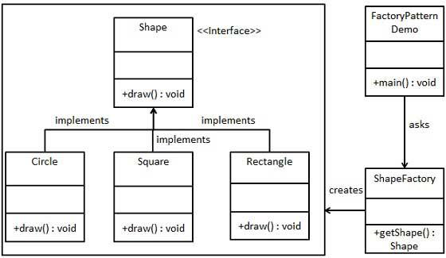
Factory Pattern Implementation
We're going to create a Shape interface and concrete classes implementing the Shape interface. A factory class ShapeFactory is defined as a next step.
FactoryPatternDemo, our demo class will use ShapeFactory to get a Shape object. It will pass information (CIRCLE / RECTANGLE / SQUARE) to ShapeFactory to get the type of object it needs.
CLASS DIAGRAM :

Slide 4
Steps for Implementation
Step 1 -
Create an interface. – Shape.java
public interface Shape {
void draw();
}
Step 2 -
Create concrete classes implementing the same interface.
Rectangle.java
public class Rectangle implements Shape {
@Override
public void draw() {
System.out.println("Inside Rectangle::draw() method.");
}
}

Slide 5
Step 3 -
Create concrete class implementing the same interface.
Square.java
public class Square implements Shape {
@Override
public void draw() {
System.out.println("Inside Square::draw() method.");
}
}
Step 4 -
Create concrete class implementing the same interface.
Circle.java
public class Circle implements Shape {
@Override
public void draw() {
System.out.println("Inside Circle::draw() method.");
}
}

Slide 6
Step 5 -
Create a Factory to generate object of concrete class based on given information .
ShapeFactory.java
public class ShapeFactory {
//use getShape method to get object of type shape
public Shape getShape(String shapeType){
if(shapeType == null){
return null;
}
if(shapeType.equalsIgnoreCase("CIRCLE")){
return new Circle();
} else if(shapeType.equalsIgnoreCase("RECTANGLE")){
return new Rectangle();
} else if(shapeType.equalsIgnoreCase("SQUARE")){
return new Square();
}
return null;
}
}

Slide 7
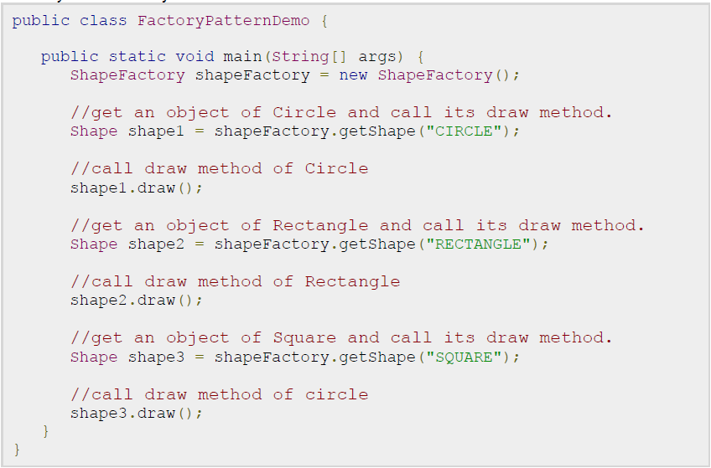
Step 6 -
Use the Factory to get object of concrete class by passing an information such as type.
FactoryPatternDemo.java
OUTPUT
Inside Circle::draw() method.
Inside Rectangle::draw() method.
Inside Square::draw() method.

Slide 8
Factory Pros & Cons.
Pros:
Shields clients from concrete classes.
If a framework follows a Factory pattern, it enables the third party developers to plug-in new products.
Cons:
Coding a new product means, writing two classes one for concrete factory and concrete product.
Inheritance based.

Slide 9
Example problem
let's create an AnimalFactory class that will return an animal object based on some data input.

